Slide 1
Opportunities and limitations of neural representations of observed action
James Goodman¹, Stefan Schaffelhofer², Hansjörg Scherberger^{1,3}
¹ Neurobiology Laboratory, German Primate Center (DPZ), Göttingen, Germany
² cortEXplore GmbH, Linz, Austria
³ Faculty of Biology and Psychology, University of Göttingen, Göttingen, Germany
SfN annual meeting
13 November 2022
Notes:
Hello everyone. Today everyone has talked about some wonderful advancements in limb BCI, and I’ll be shifting gears a bit to talk about a related piece of basic science about observation-related activity in motor areas.

Slide 2
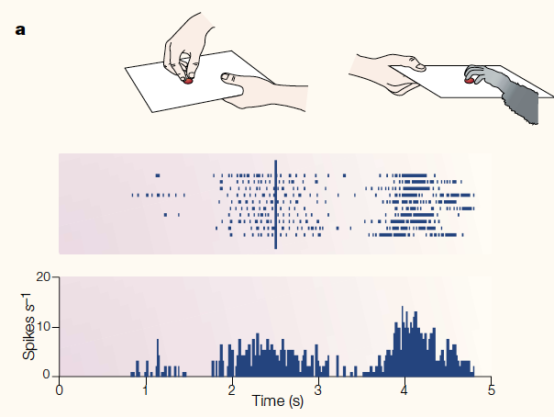
Representations of action execution and observation appear to be linked
Rizzolatti et al. 2001 Nat. Rev. Neuro
Notes:
The story of observation-related activity in motor areas cannot be told without beginning with mirror neurons. First described in 1992 by di Pelligrino et al, they comprise the set of neurons which respond during both the execution of action (as seen in the right-hand side of this example neuron’s raster) and the observation of others performing similar actions (seen on the left here), seeming to imply a link between the two types of responses.
----

Slide 3
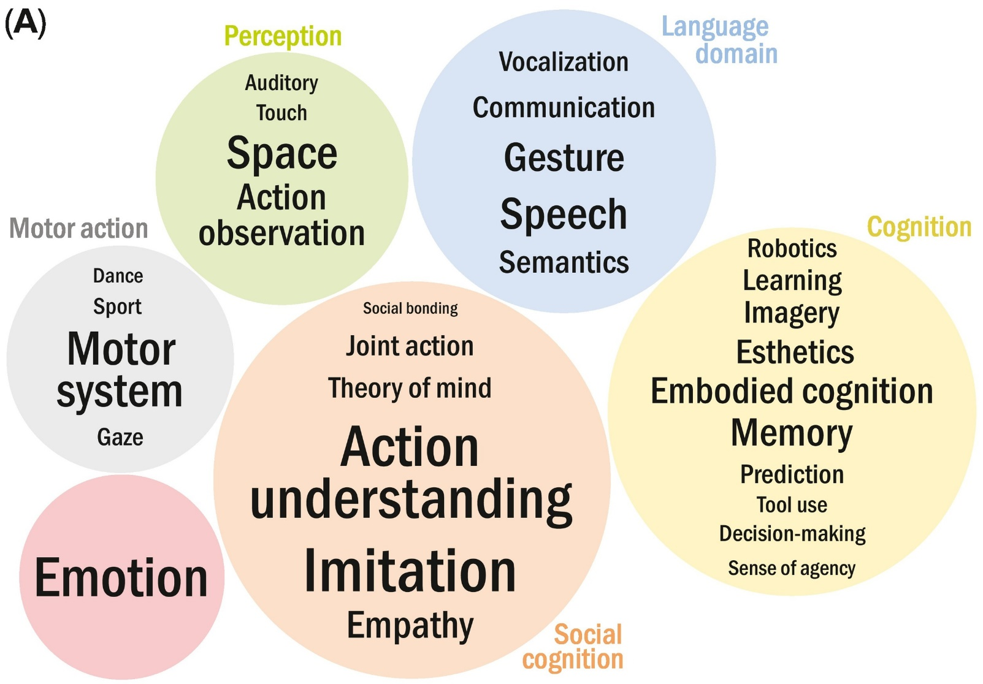
Mirror neuron activity has many hypothesized roles
Bonini et al. 2022 TiCS
Notes:
A lot of conversation and, frankly, speculation emerged about the roles played by this mirror neuron activity, as evidenced here by an overwhelming word cloud of topics (compiled by Bonini and colleagues in a recent review paper) associated with mirror neurons and, thus, with observation-related activity more generally.
----

Slide 4
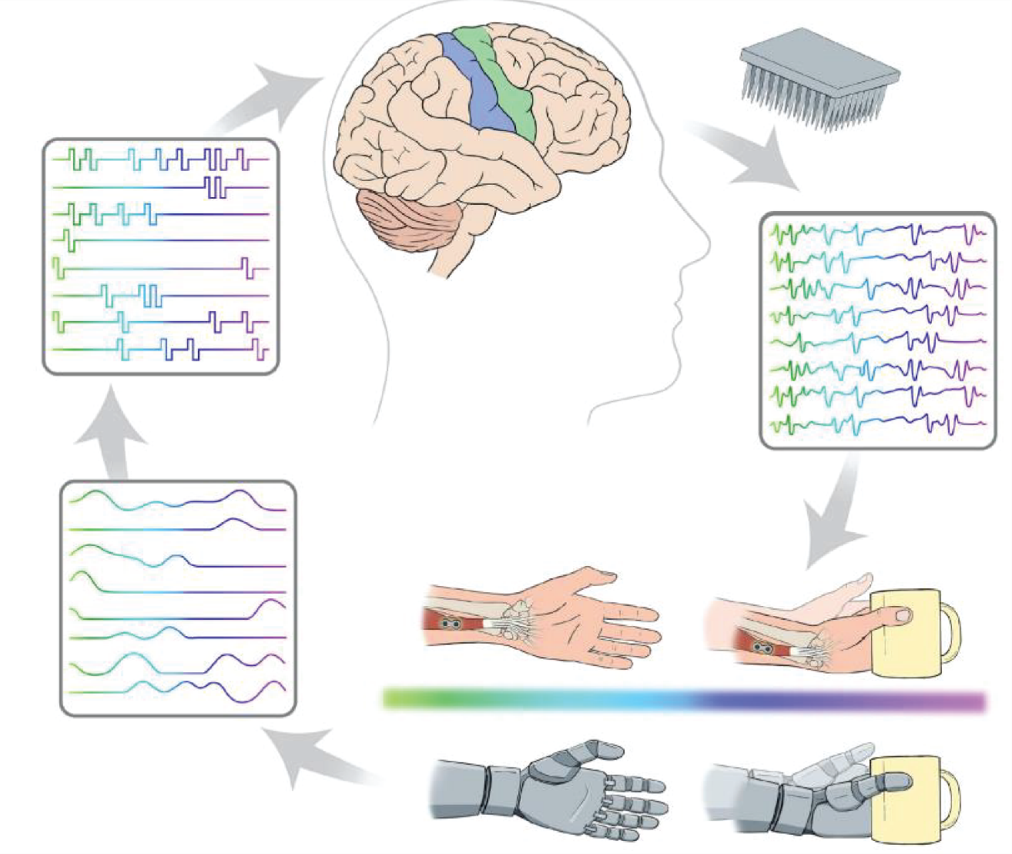
Activity during observation influences BCI decoders
Pandarinath & Bensmaia 2022
Notes:
And indeed, observation of action is frequently used in the training of BCI decoders, especially in the case of cursor control, so the design of a BCI depends on a detailed knowledge of what is happening in the brain during observation.

Slide 5
Are there fine or coarse representations of observed movements?
Hypothesis space:
Muscle resolution
Grip type resolution
Invariant
Notes:
However, I wouldn‘t call our understanding of observation activity “detailed”. Once you get beyond the fact that it exists, disagreement quickly emerges regarding how granular the information content of observation activity I – i.e., whether fine or coarse representations of observed movements are instantiated. Some hypotheses related to “motor resonance” suggest that a precise spatiotemporal sequence of muscle activations should be simulated in observation-related activity. Some hold that this may be too much detail, but discerning among different grip types should still be possible from observation activity. Still others hold that observation-related activity should be largely invariant to most specific details of the movement itself, instead capturing information about the high-level goal of a movement, if anything.

Slide 6
Are there fine or coarse representations of observed movements?
Hypothesis space:
Muscle resolution
Grip type resolution
Invariant
Notes:
And I hope to convince you today to reject hypotheses on the „fine“ end of this hypothesis space, leaving only the „coarse“ part.

Slide 7
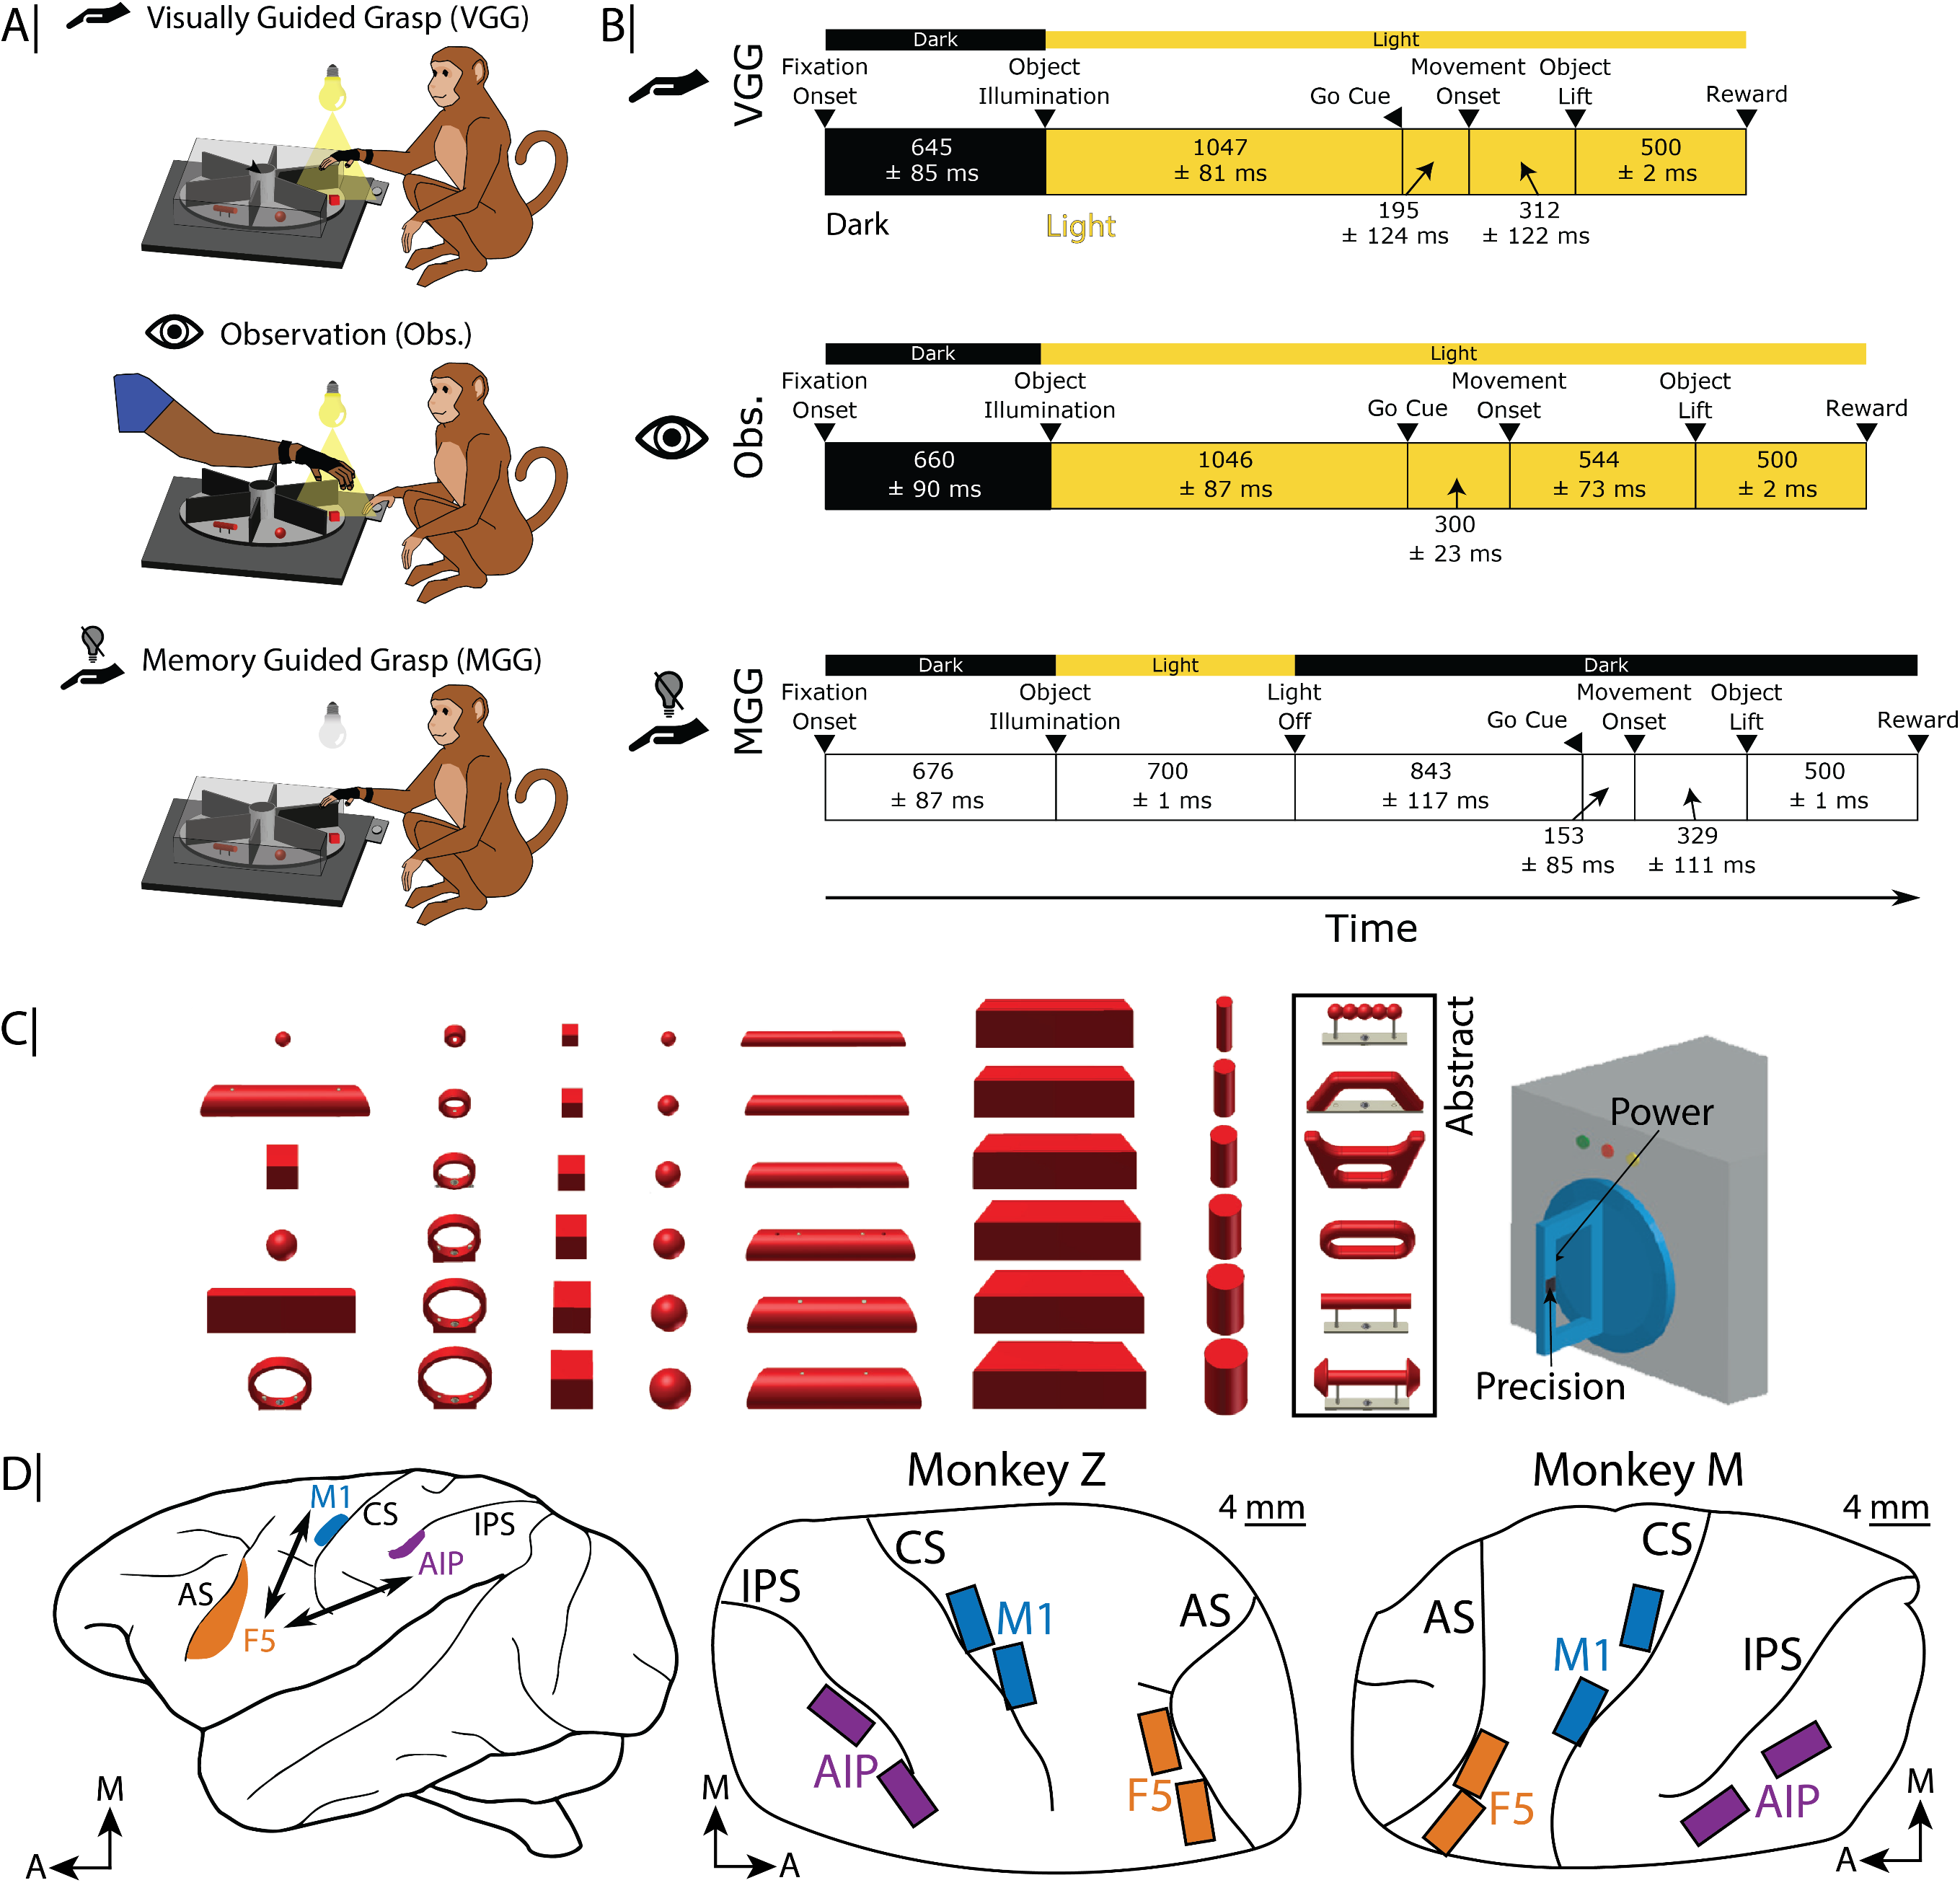

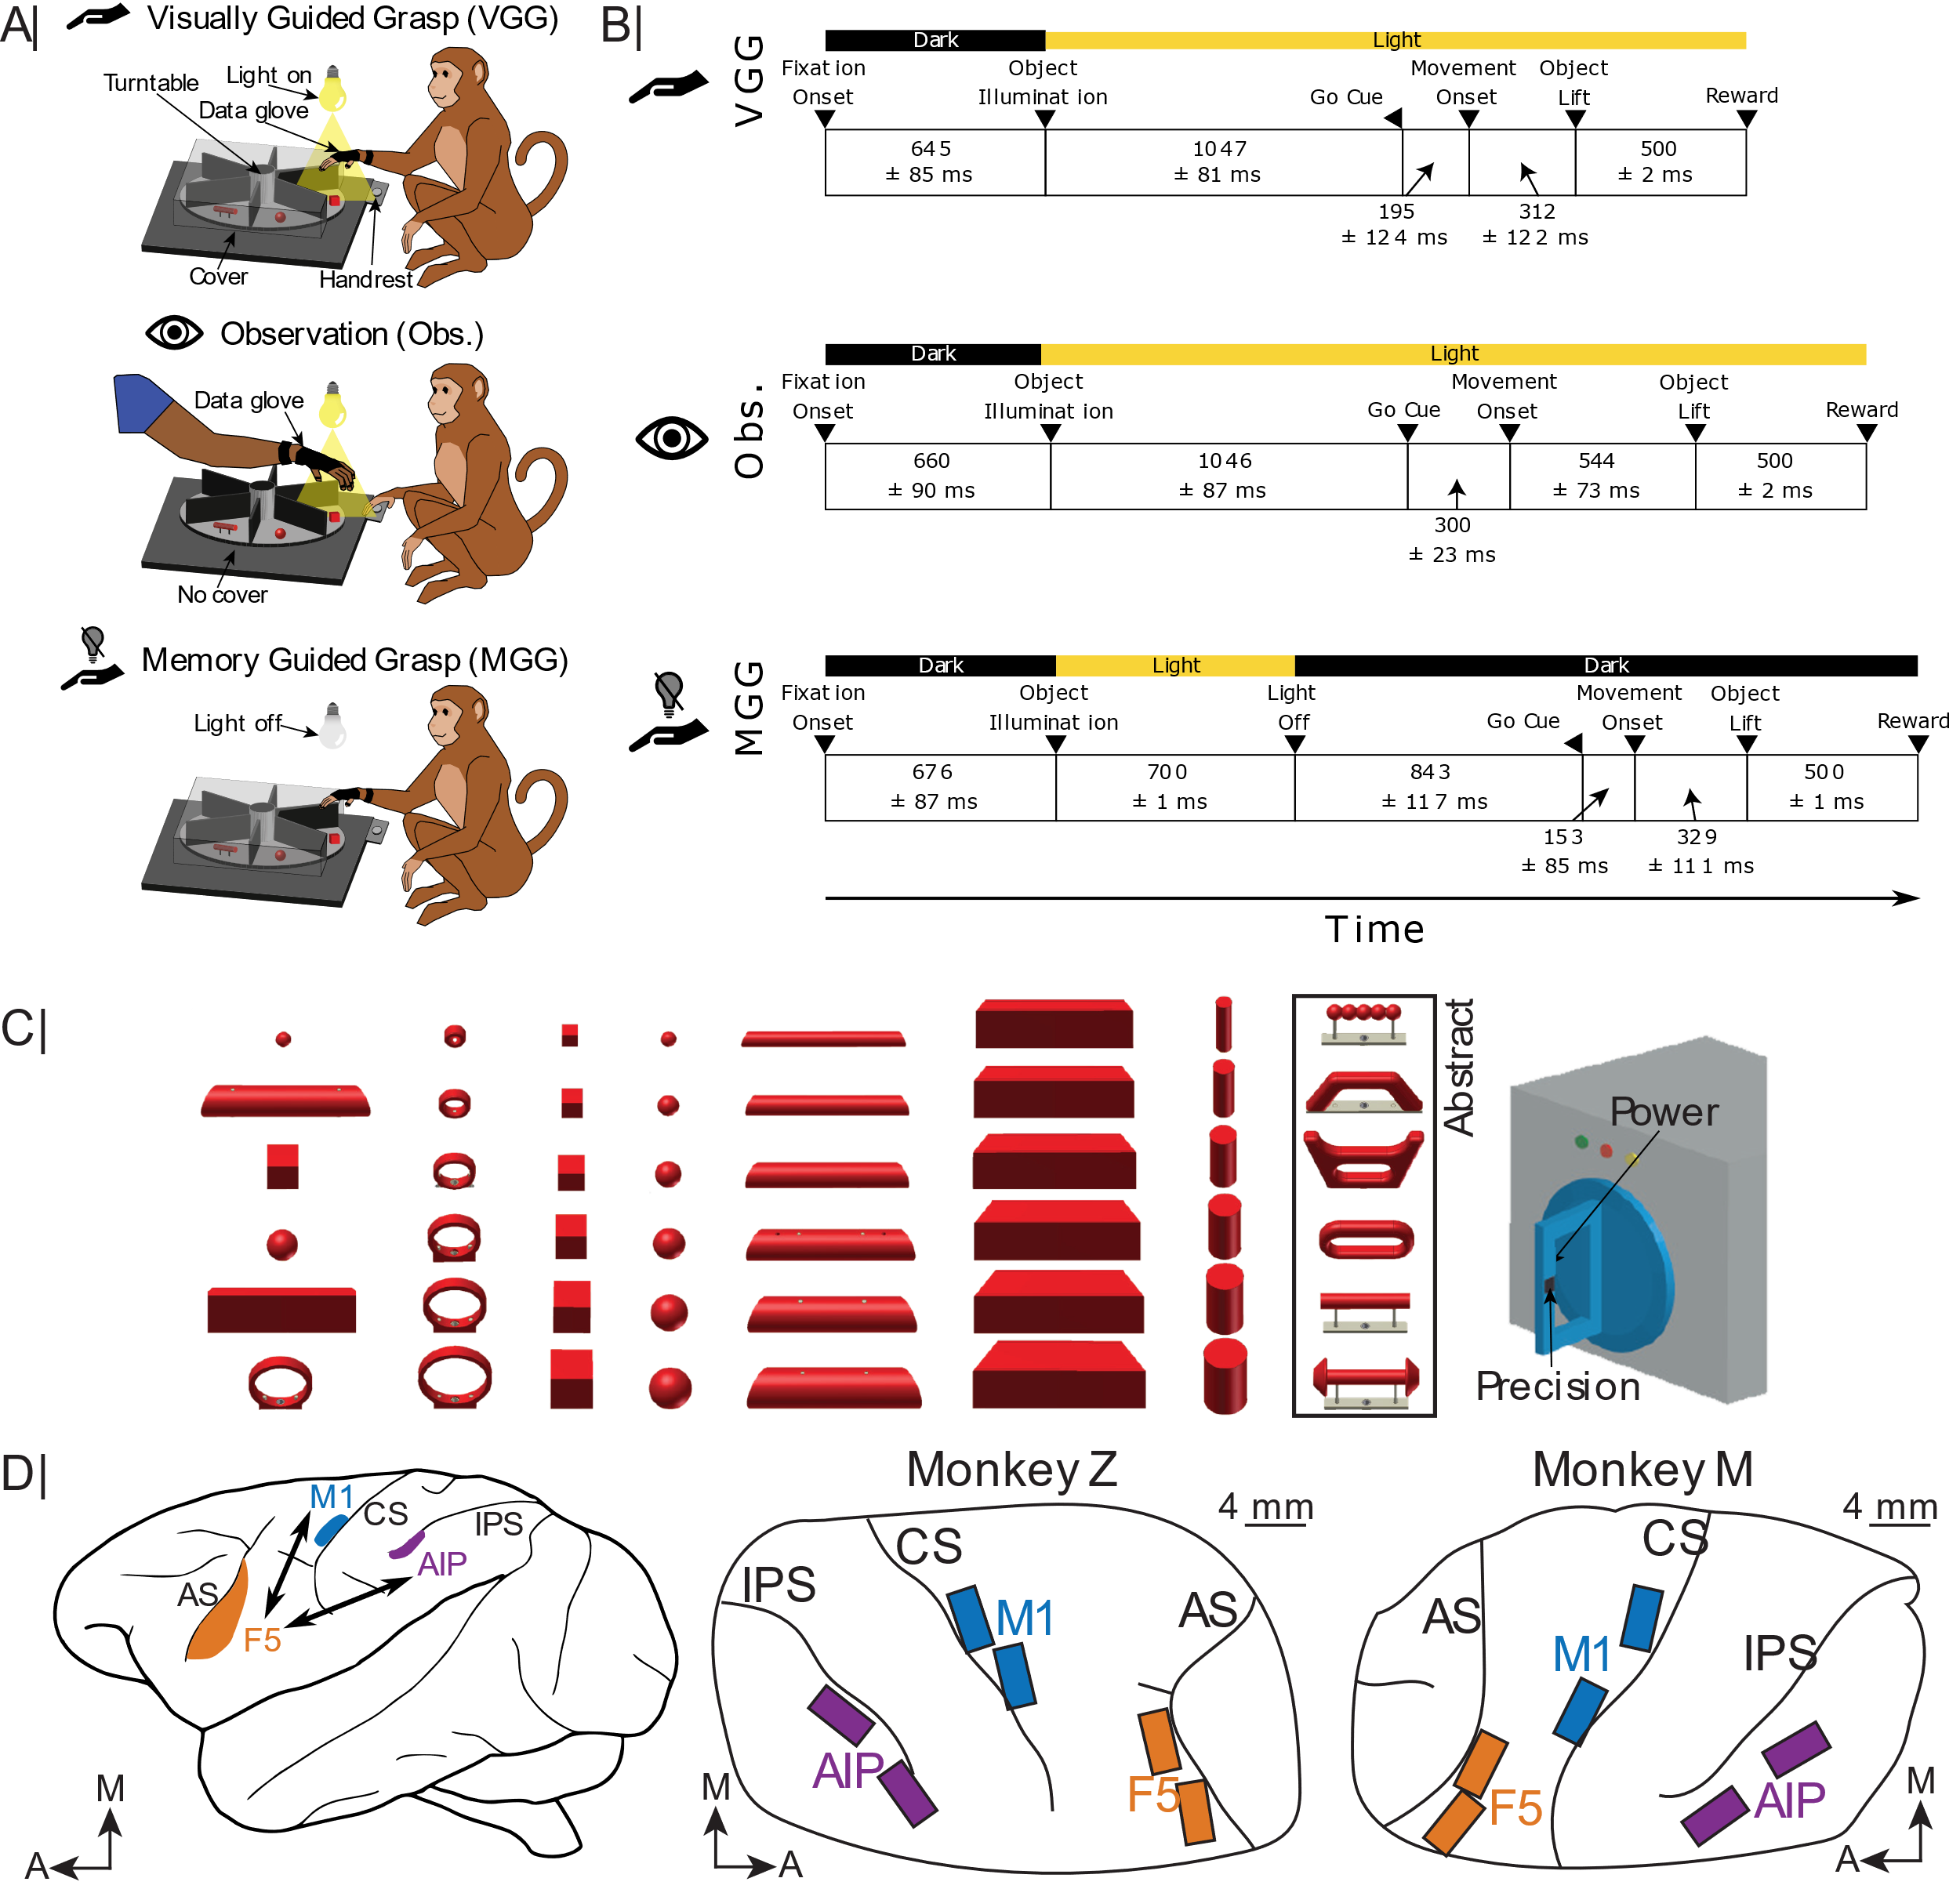
Turntable experiment samples a wide variety of grips
Turntable methodology:
Schaffelhofer & Scherberger 2012 JNE
Schaffelhofer et al. 2015 J Neurosci
Schaffelhofer & Scherberger 2016 eLife
Notes:
To study this, we used a turntable task with an execution (VGG) and observation (Obs.) context, with a snapshot of each during movement in the top-left. In the top-right we see the progression of events throughout this task, where either the animal or its human partner sits in the dark until the object is illuminated, then waits until a go cue is presented at which point they move to grasp and lift the object, triggering a reward.
On the bottom are the series of objects presented in this task: we used 8 turntables in total, 4 per recording session in a block design, with 6 objects per turntable presented in pseudo-randomly interleaved order. This produced a wide variety of distinct grips to study (12-18, depending on the agent).

Slide 8
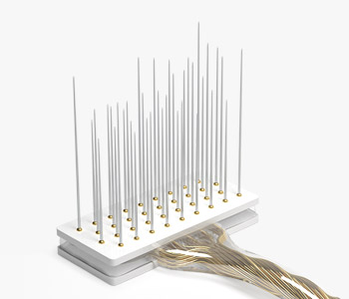
Floating microelectrode array (FMA) implants record populations from the three main areas in the grasping network
IPS: Intraparietal sulcus M1: Primary motor cortex M: Medial
CS: Central sulcus F5: Rostroventral premotor cortex A: Anterior
AS: Arcuate sulcus AIP: Anterior intraparietal area
Notes:
During this task, we also implant 2 floating microelectrode arrays (FMAs), each with 32 channels, in each of M1, F5, and AIP, thereby enabling simultaneous population recordings in three key nodes of the primate grasping network, the entirety of which has been tied to observation activity to some degree.

Slide 9
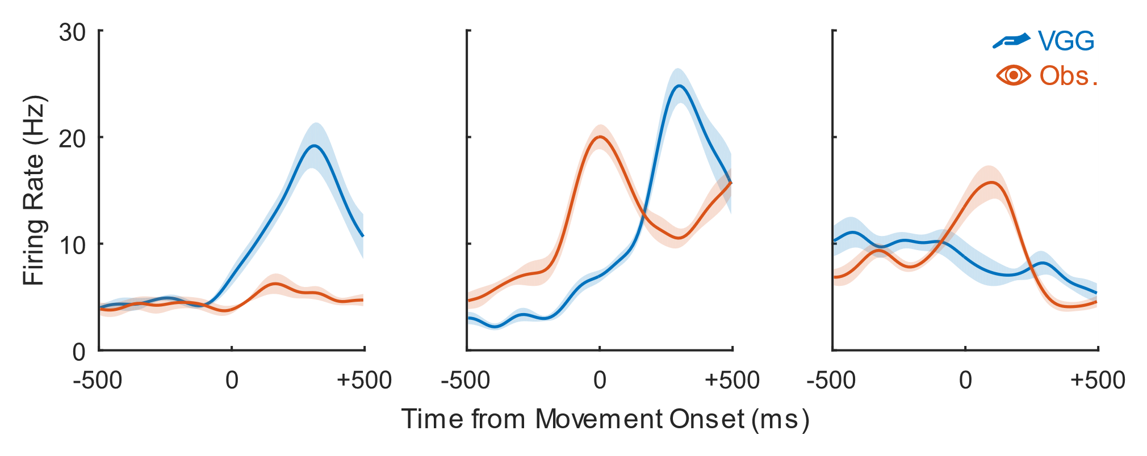
A continuum of preference for observed action emerges
Three example neurons:
“Action-type”
“Mirror-type”
“Observation-type”
Notes:
From these recordings, we first take a little detour and ask if there exists a distinct subclass of neurons which is particularly sensitive to observed action – i.e., the mirror neurons. Shown here are three example neurons, showcasing the continuum of responses we observe throughout F5. We find “action-type” neurons which preferentially respond during the execution context, “observation-type” neurons which actually prefer the observation context, and “mirror-type” neurons which respond with similar magnitude during both contexts.

Slide 10
A continuum of preference for observed action emerges
Passive-Active Index
-1
0
+1
Three example neurons:
“Action-type”
“Mirror-type”
“Observation-type”
Notes:
We devise a passive-active index to quantify neurons based on their relative preference for execution and observation – although as an aside, we use modulation across grip types and time, rather than raw firing rate, to compute this index, and also pre-select neurons using a modest 1Hz range criterion.

Slide 11
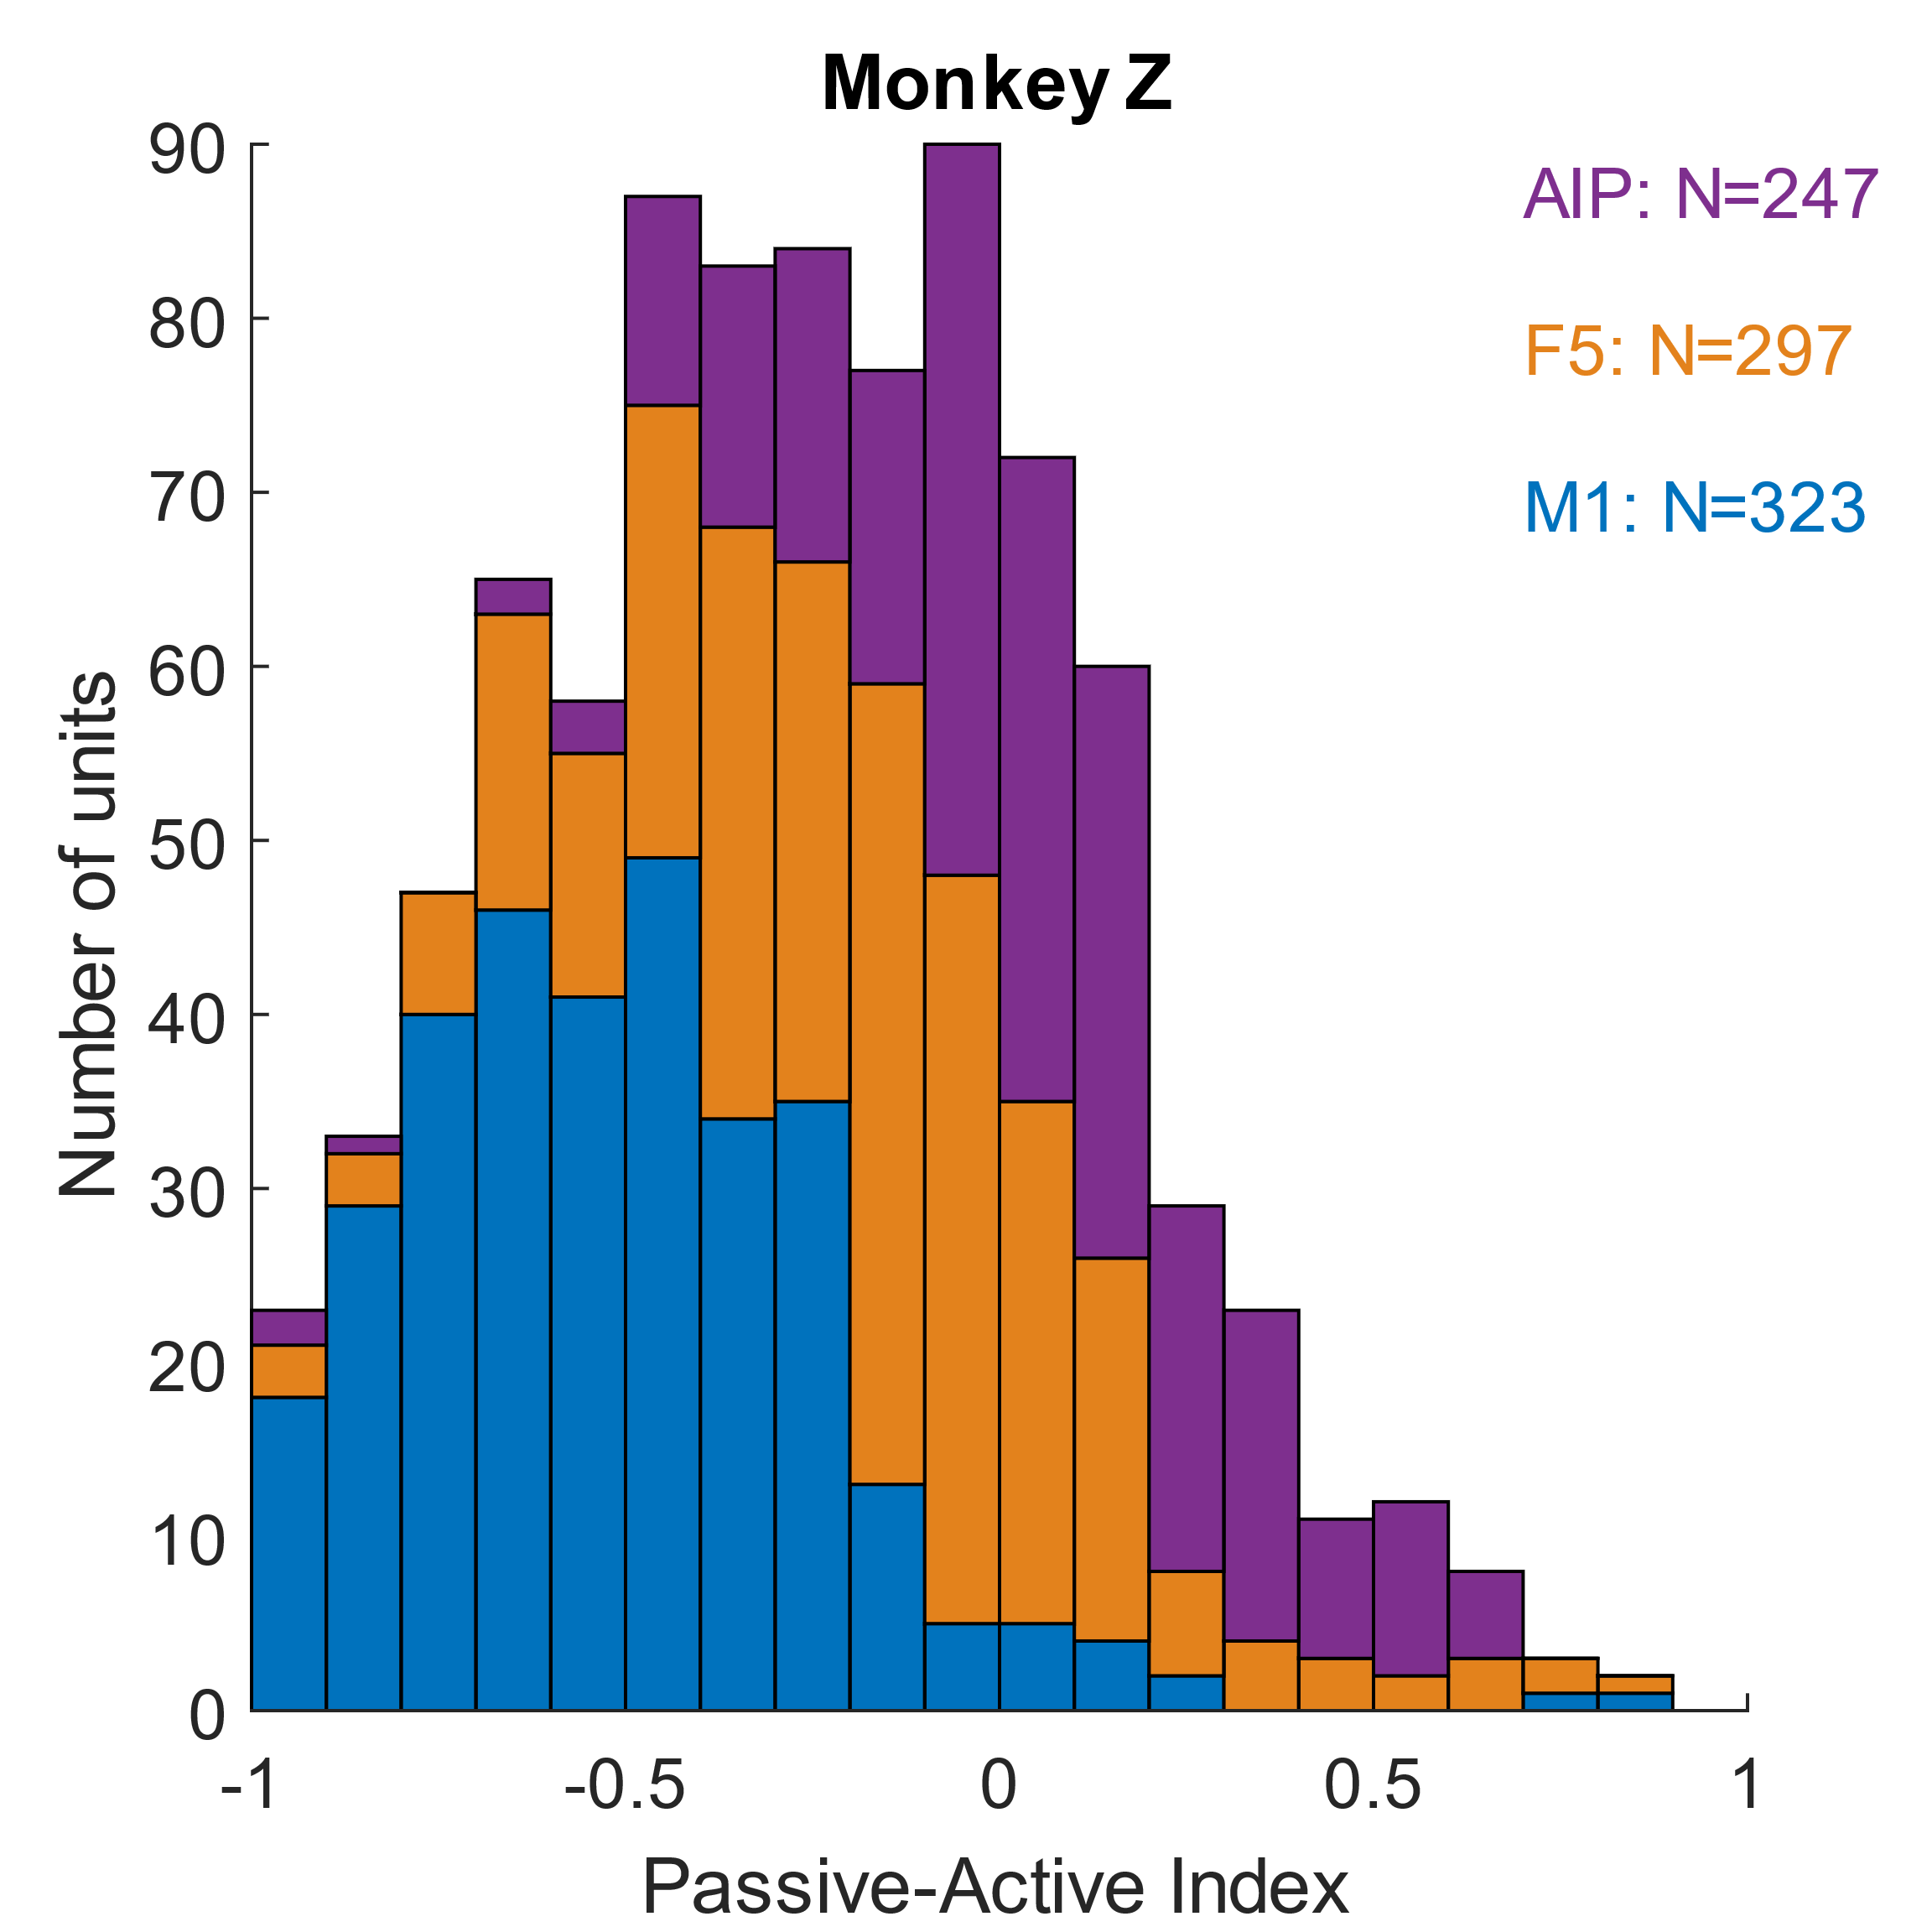
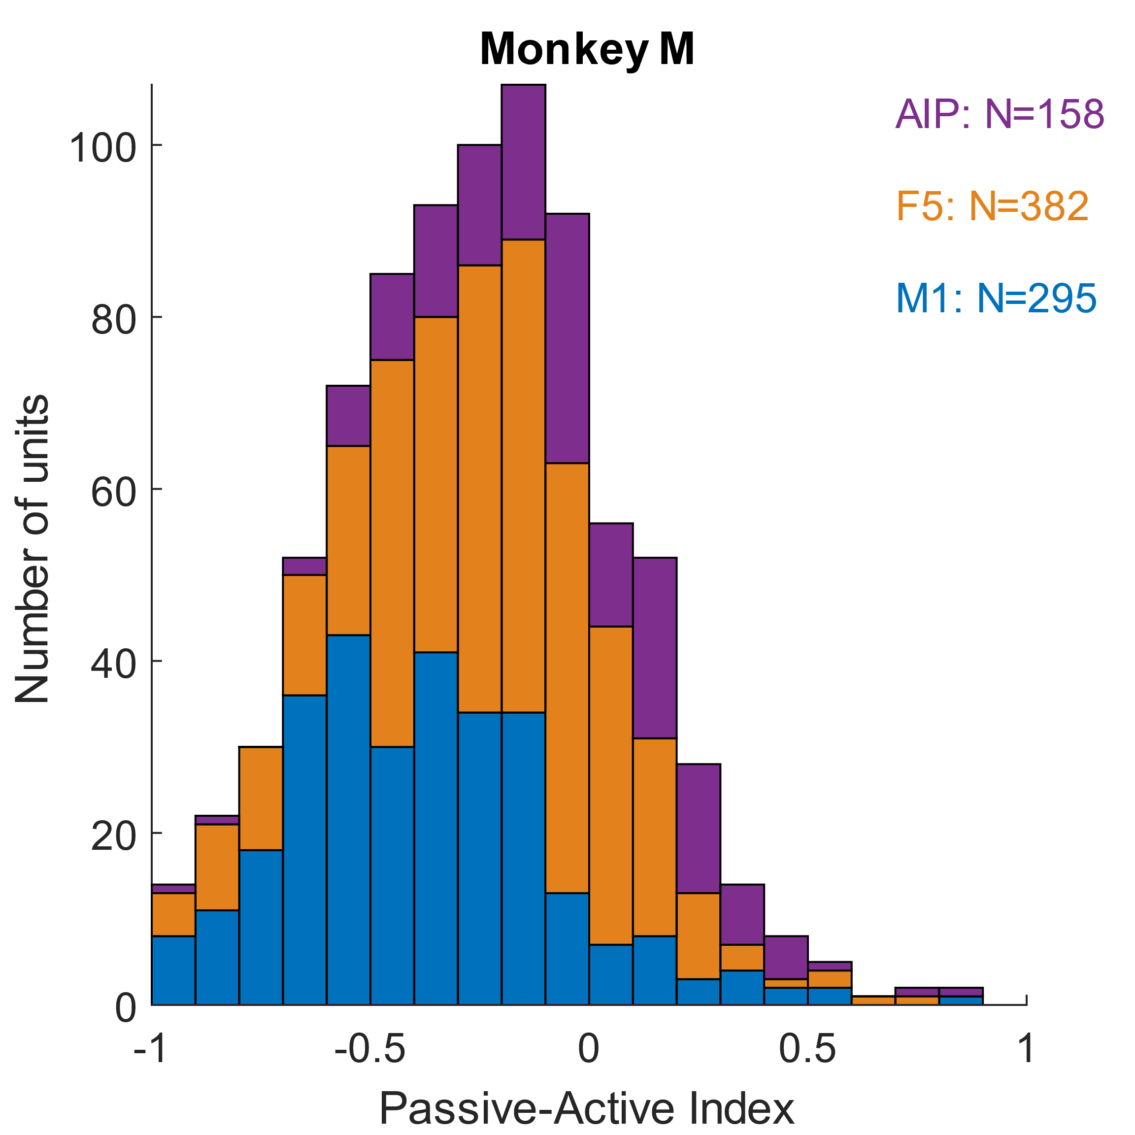
An observation-preferring neuron class does not emerge
Notes:
We quantify the entire population according to this metric and, within no cortical area and indeed, not even when pooling across areas do we see evidence of clustering in the neural population – preference for observation and execution exists along a smooth continuum, albeit one whose mean shifts as one progresses from the highly visual AIP to the execution-concerned M1.

Slide 12
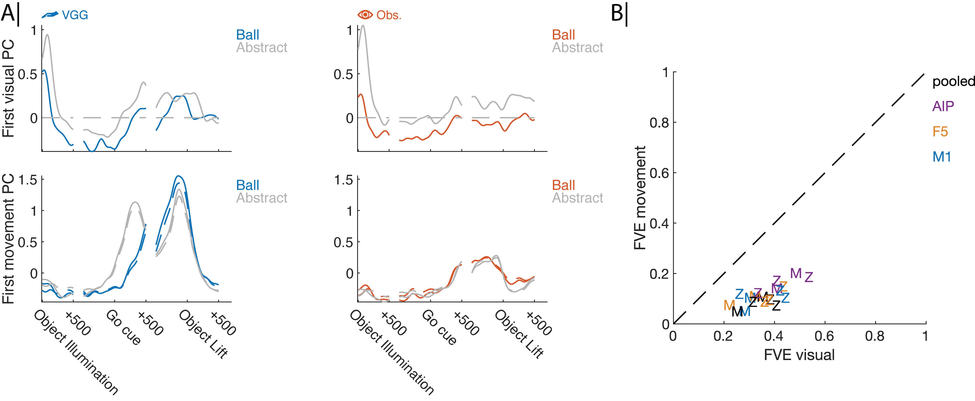
Activity related to object vision confounds many analyses, but can be surgically removed
Pre-remove
Post-remove
Notes:
From here, we decide to use population-level analyses to understand the representational granularity of observation activity, since there are no mirror neurons to confine our analysis to. However, I need to make one other quick detour: namely, that population-level analyses are *powerful* and likely to pick up on effects related to object vision and even the block design of our task. For this reason, we looked to see if we could isolate this activity into a subspace distinct from that in which movement-related representations were contained.
Indeed, we found that we could: to illustrate this, on the left, we observe neuronal activity plotted on the first principal component of the first 500ms following object illumination. The two different traces correspond to different objects. We see that this activity persists throughout the object lift epoch, when movement is being actively executed. However, if we then remove this activity by setting all values to zero (dashed lines), then shift our focus to the first PC of activity in the 1s window surrounding object lift, we find that the dashed lines nearly overlap with the solid lines, indicating that the movement-related space is largely orthogonal to the vision-related space.
Note in this case that I am illustrating a 1-D example, but the subspaces being removed here are 2-7 dimensional, depending on the animal, area, and recording session.
----

Slide 13
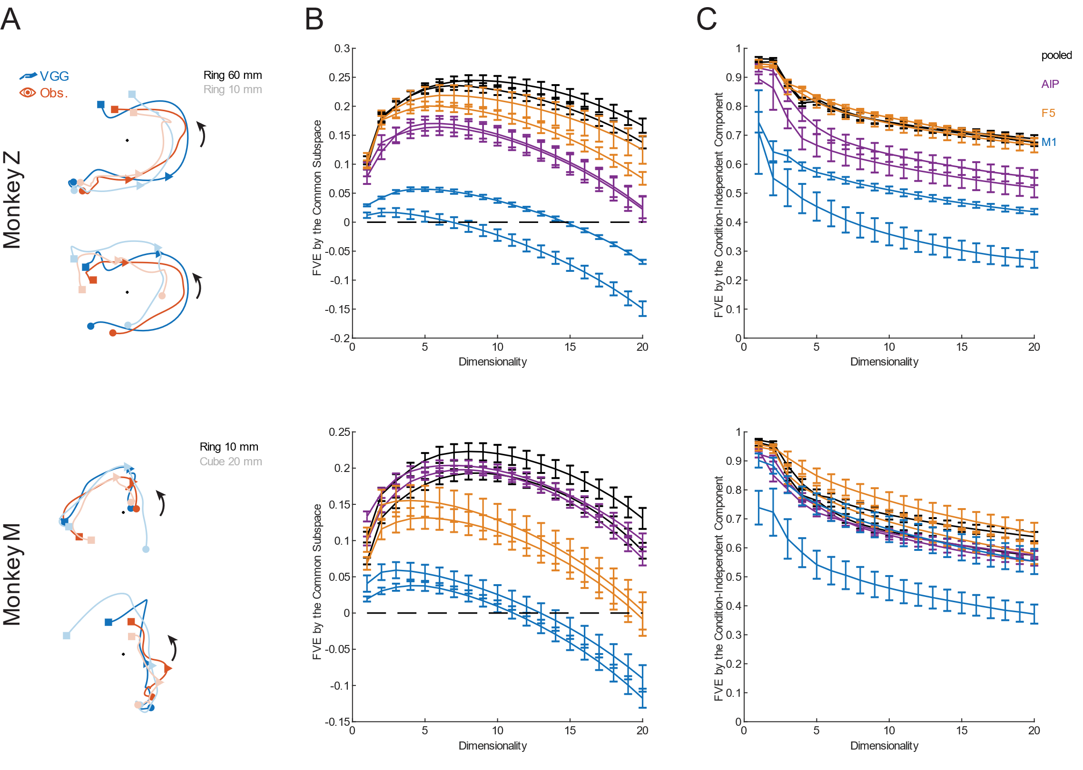
Shared population activity is substantial, but invariant to grip
Monkey M
Monkey Z
18% variance capture
13% variance capture
-500 ms
Movement onset
+500 ms
Notes:
…and once we’ve done all that, we’re ready to start visualizing neural activity to look for representations of observed grips.
The first thing we do is look for a common representation of objects between executed and observed grips, with the idea being that the presence of a given object may produce simulation of the monkey’s own grasp of that object even if the human partner gripped it differently. Shown here are 2D subspaces which maximize the degree of congruence between execution- and observation-related activity patterns, and while we find a good deal of overlap between these two contexts, we also find a good deal of overlap across the different objects (represented here by color saturation).
Note that this example is in F5. This result holds in AIP, but the variance captured by this shared component in M1 is comparatively tiny (fails to go beyond 5% variance explained).

Slide 14
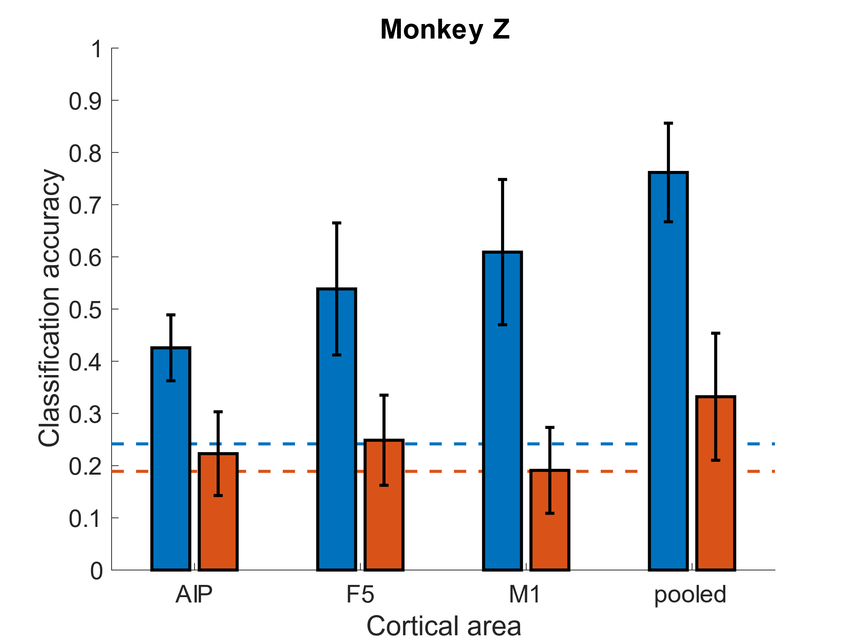
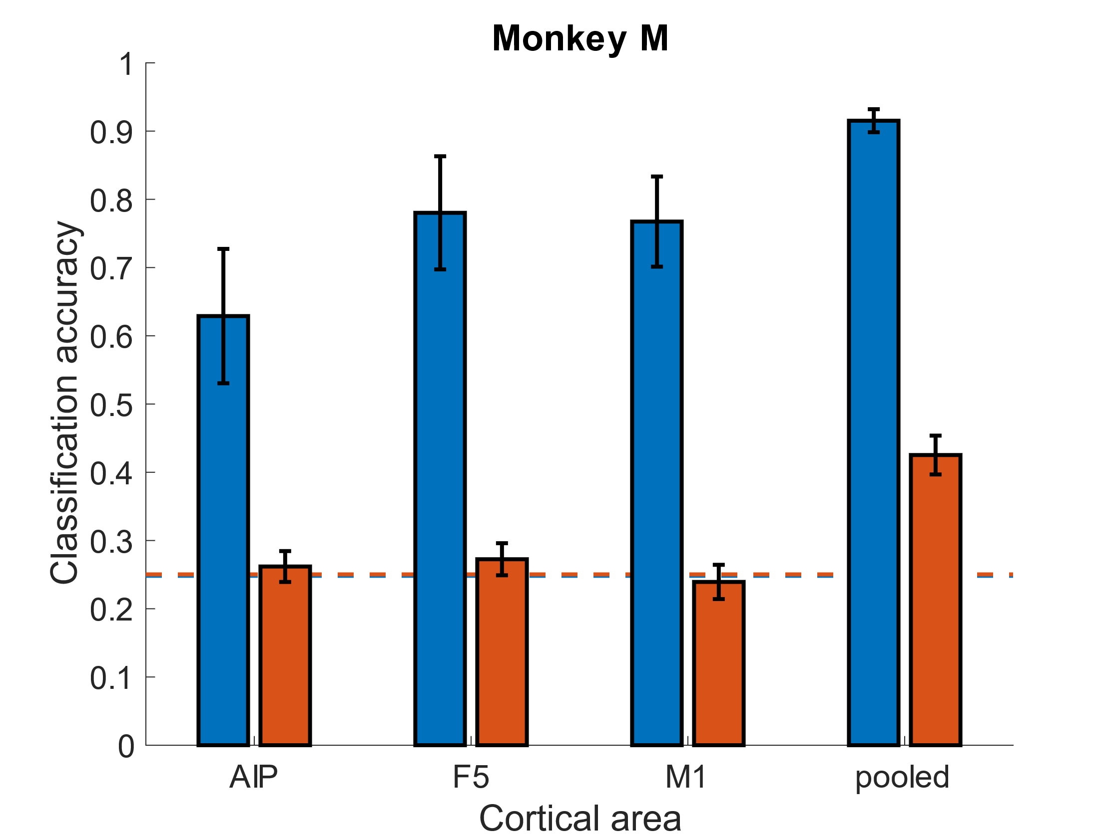
Representation of observed grips is weaker than expected
Chance
Notes:
However, because grip types are indeed dissimilar between the two contexts, we then assess to what extent there is a representation of grip type during the observation context at all.
Here, we train a *bunch* of classifiers in parallel using a high-performance computing cluster to assess the accuracy of LDA classifiers on neural data aligned to the last 500ms prior to lift and hold of the object – and a bunch of controls that I do *not* have time to go into today
And in most cases, even though execution classifiers perform well above chance, observation classifiers rarely do
----

Slide 15
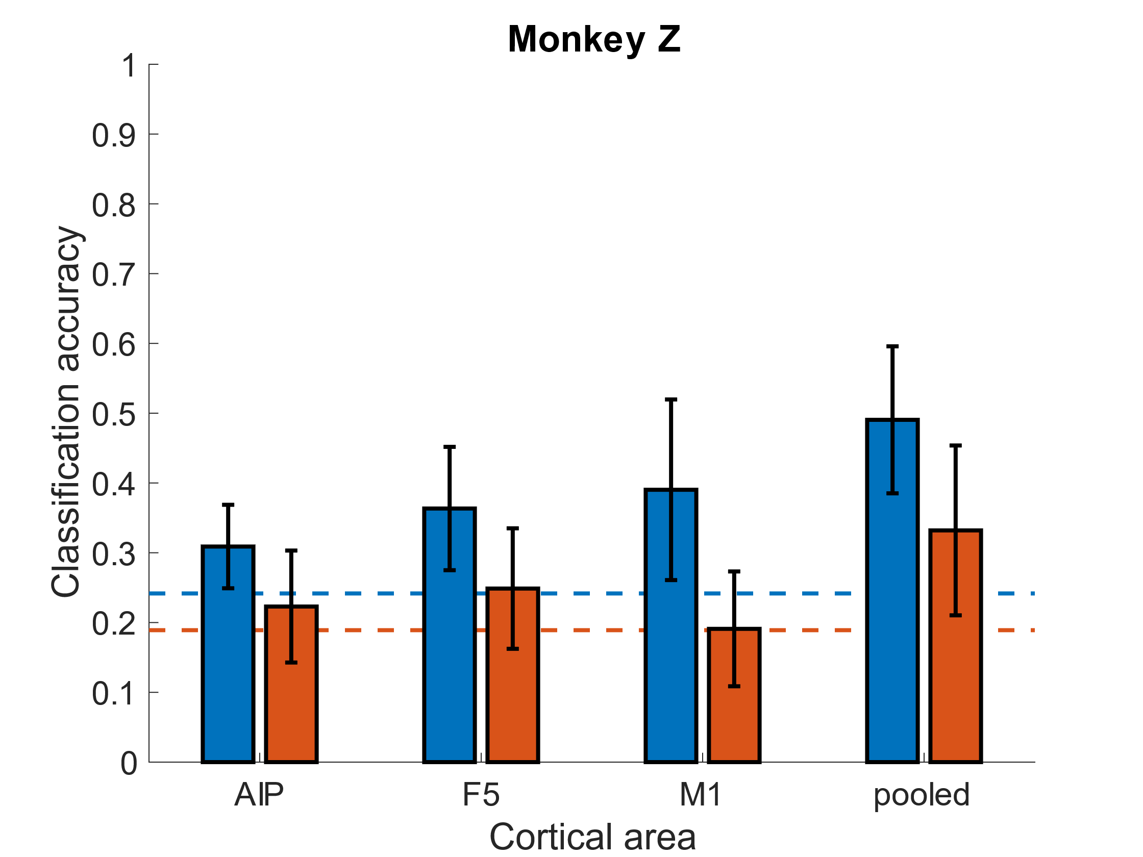
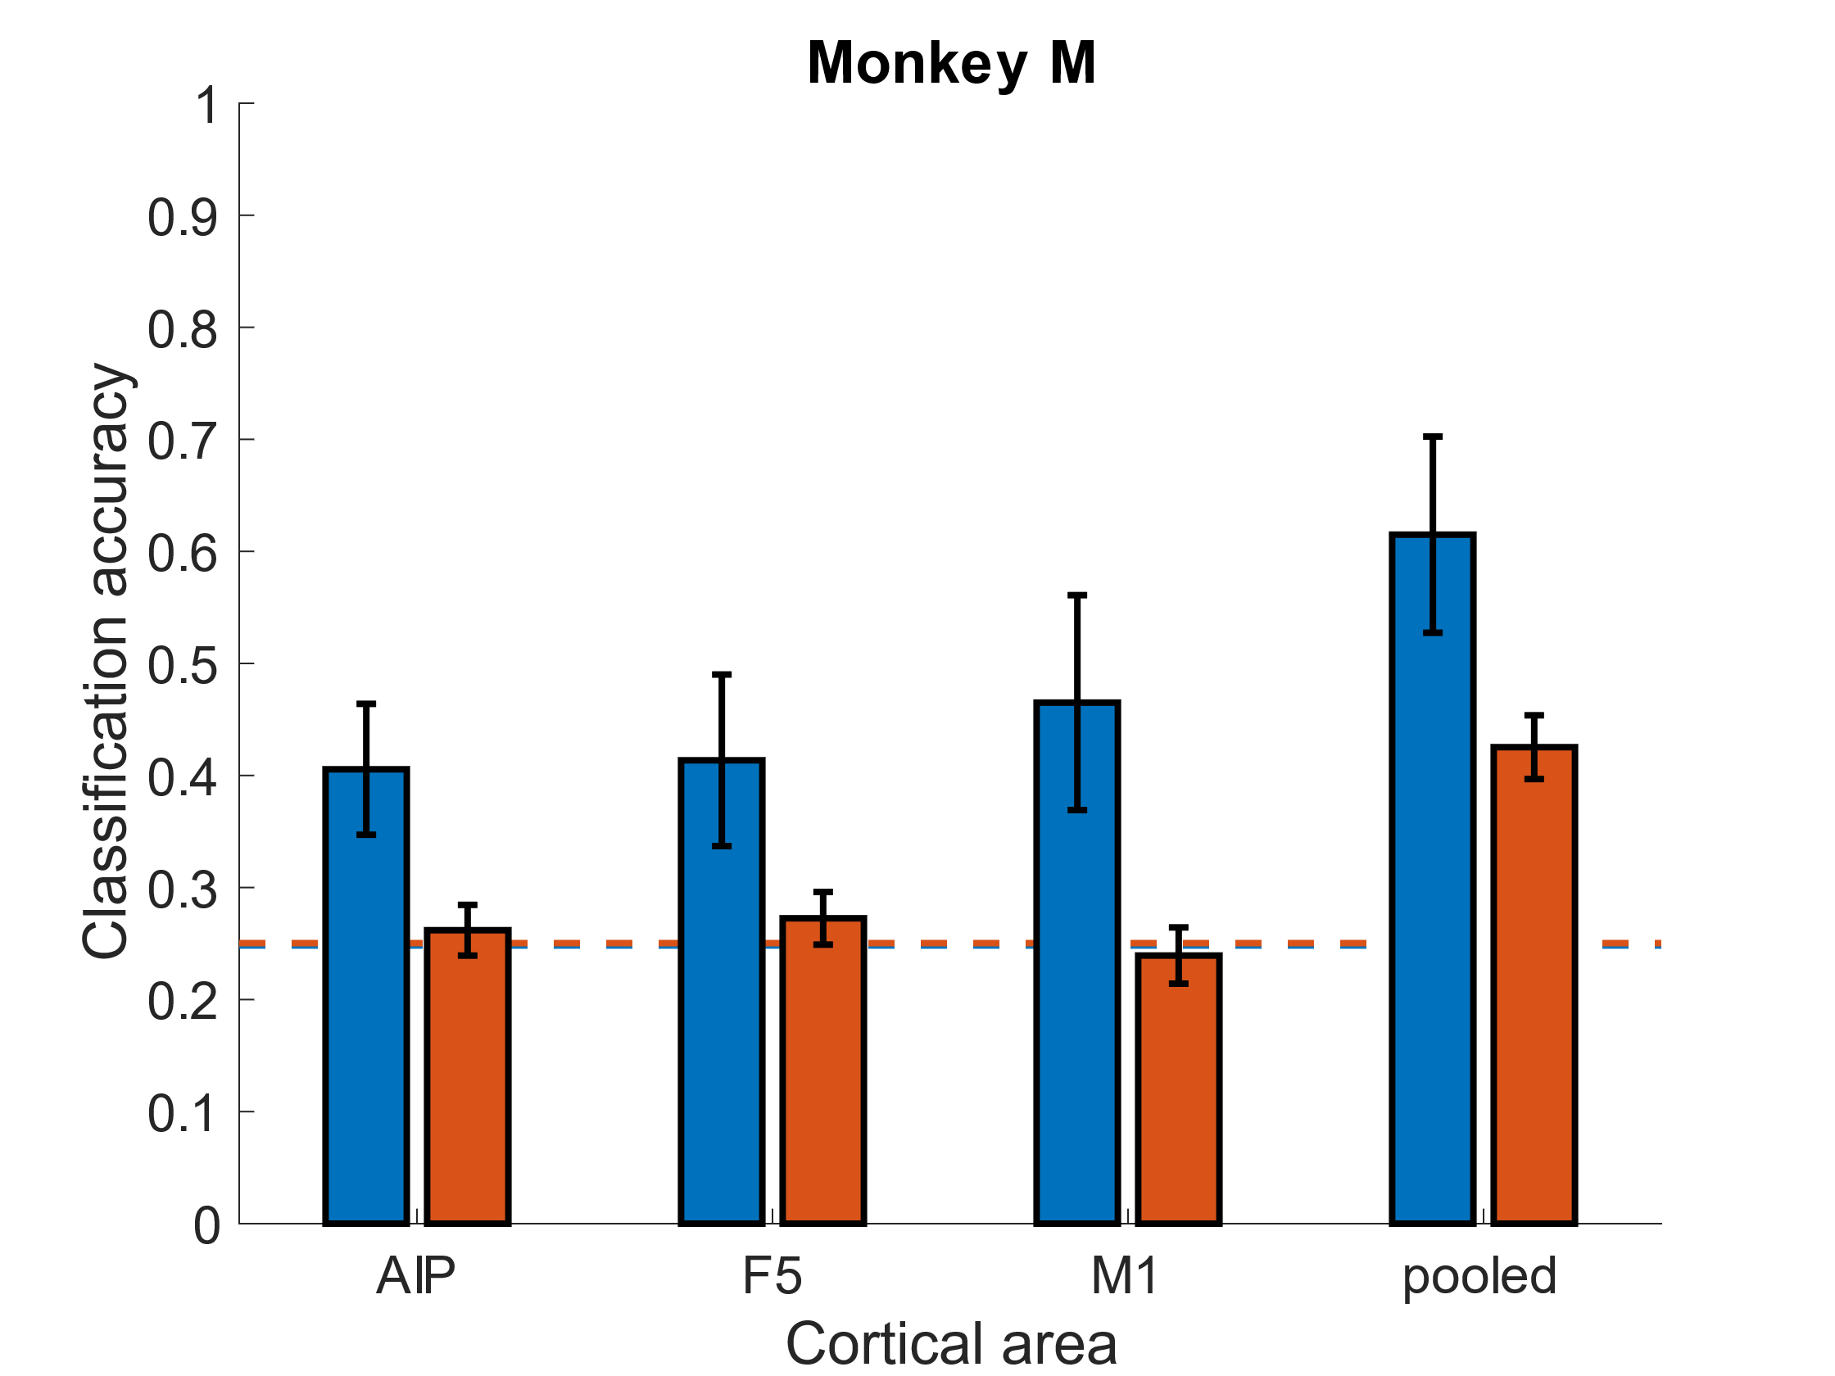
Representation of observed grips is weaker than expected
(10% subsample)
Chance
Notes:
Of course, this may not be surprising if the observation condition comprises, say, 10% of variance of the VGG context, which would fall in line with the classical view that 10% of mirror neurons should be „strictly congruent“ mirror neurons.
Therefore, we simulate the case where we only had 10% of the neuronal population available to decode grip type during the VGG context and find that it still significantly outperforms both the observation context and chance level in all cases.
----

Slide 16
Summary & Conclusions
There is a substantial activity pattern in F5 and AIP shared between action execution and observation contexts
This shared activity is not grip-specific
Observation-related activity is less grip-selective than predicted by classical hypotheses about the prevalence of congruent mirror neurons
This implies distinct representations for action execution and fine-resolution action understanding
In a BCI context, the helpful training signal is almost certainly explicit rehearsal, rather than resonant activation triggered by pure observation
Notes:
In summary, then:
There *is* a substantial activity pattern in F5 and AIP which is shared across execution and observation contexts
However, this shared activity pattern is not grip-specific
In fact, observation-related activity is less grip-selective than predicted by classical hypotheses about congruent mirror neurons
This all implies that there are distinct representations for action execution and fine-resolution action understanding, as the latter is predicated on a fine-grained grip representation during the observation context.
Moreover, in a BCI context, this implies that during observation learning, the helpful training signal is almost certainly explicit rehearsal .from the user prompted by the visual stimulus, rather than any resonant activation purely attributable to observation in and of itself.

Slide 17

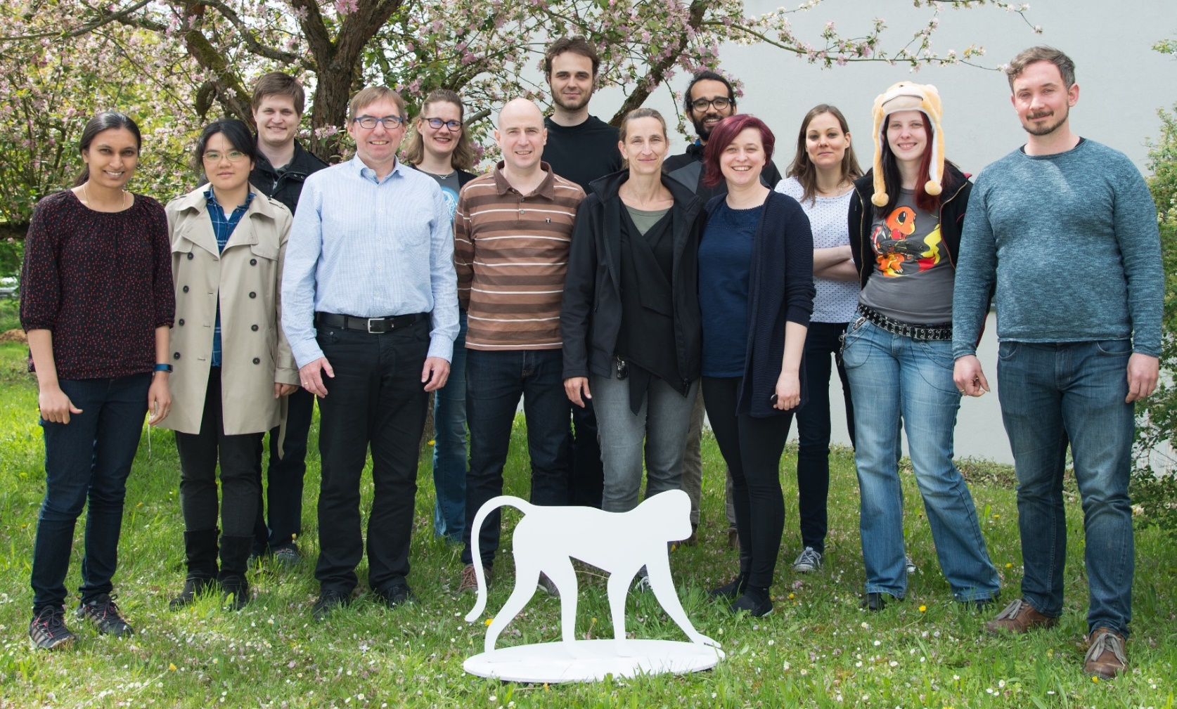



Acknowledgments
Co-funded by the European Union
✶ jamesgoodman.me
 linkedin.com/in/james-goodman-phd/
Neurobiology Laboratory ca. 2018
Notes:
And with that, I would like to plug:
me, check me out, I’m great and I’m currently trying to answer the inevitable career question “what comes after the postdoc?”, so if you or somebody you know has work that needs to be done involving stats, data analysis, machine learning, or anything involving a similar set of responsibilities and skills, let me know.
I’d also like to plug:
*the Neurobiology lab at the DPZ*
*these external funding agencies which enabled the data collection*
*and of course the DPZ and the Leibniz association*

